Slide 1
Sistem Pengaturan Formasi dan Kolaborasi (2 sks)
EE185523
Yurid Eka Nugraha
TSP DTE FTEIC ITS

Slide 2
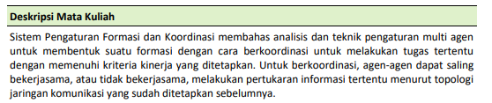
Deskripsi mata kuliah
(Kurikulum 2018 DTE ITS)
EE185523 2022E – 0

Slide 3
Topik/pokok bahasan
Konsep Sistem Pengaturan Multi Agen dan Aplikasinya
Protokol Kesepakatan
Pengaturan Formasi dan Koordinasi
Koordinasi Estimasi Terdistribusi Berbasis Multi Agen
Koordinasi Optimisasi Terdistribusi dalam Multi Agen
Noncooperative agent
Multi Agent Markovian Decision Processes
EE185523 2022E – 0

Slide 4
Referensi
F. Bullo, Lectures on Network Systems, 2018
M. Mesbahi and M. Egerstedt, Graph Theoretic Methods in Multiagent Networks, 2010
W. Ren and R. W. Beard, Distributed Consensus in Multi-vehicle Cooperative Control: Theory and Application, 2008
F. L. Lewis, H. Zhang, K. Hengster-Movric, A. Das, Cooperative Control of Multi-Agent Systems: Optimal and Adaptive Design Approaches, 2015
EE185523 2022E – 0

Slide 5
Rencana perkuliahan (tentatif)
Minggu ke-:
Introduction and overview
Graph theory & Matrix theory
Consensus
Consensus
Consensus
Formation control
Midterm
Formation control
Distributed estimation
Distributed optimization
Games over networks
Games over networks
Markov decision process
Markov decision process
Final exam
EE185523 2022E – 0

Slide 6
Komponen penilaian
Tugas: 30%
ETS: 25%
EAS: 30%
Quiz: 15%
Ketidakhadiran <= 25% untuk lulus
EE185523 2022E – 0

Slide 7
Lain-lain
Dosen:
Yurid Eka Nugraha
AJ-104/B105(?)
yurid.e@yahoo.com
Materi perkuliahan diupload di yurideka.github.io
password: magnus egerstedt
EE185523 2022E – 0

Slide 8
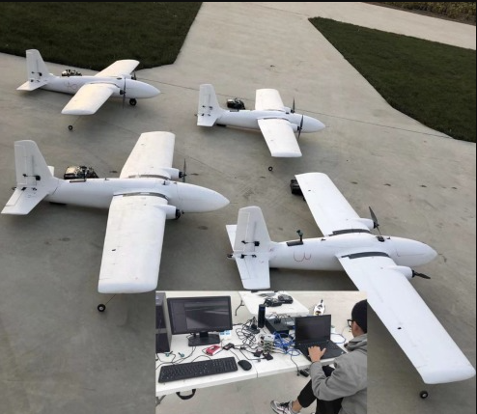
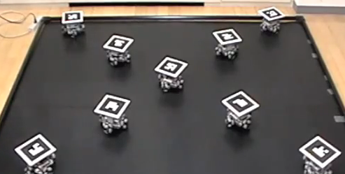
Formation control?
(digi.com)
(sciencedirect.com)
EE185523 2022E – 0

Slide 9
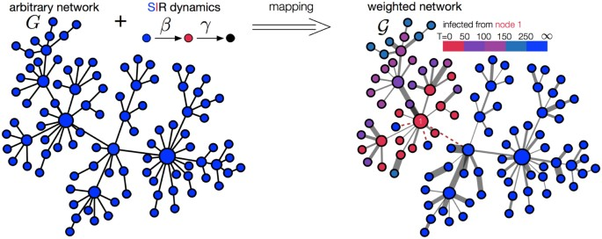

Formation control?
(nature)
Formation control
Control over network
EE185523 2022E – 0

